Slide 1
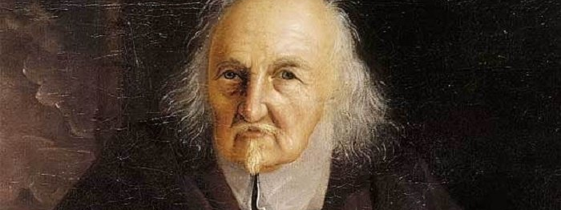
Hobbes and the state of nature
GV100 class slides: MT week 7
London School of Economics and Political Science

Slide 2
Questions/comments to start the class
Remember, these can just be simple questions or comments about the material.
It is always worth it to ask a question if you are confused or not fully sure about something!

Slide 3
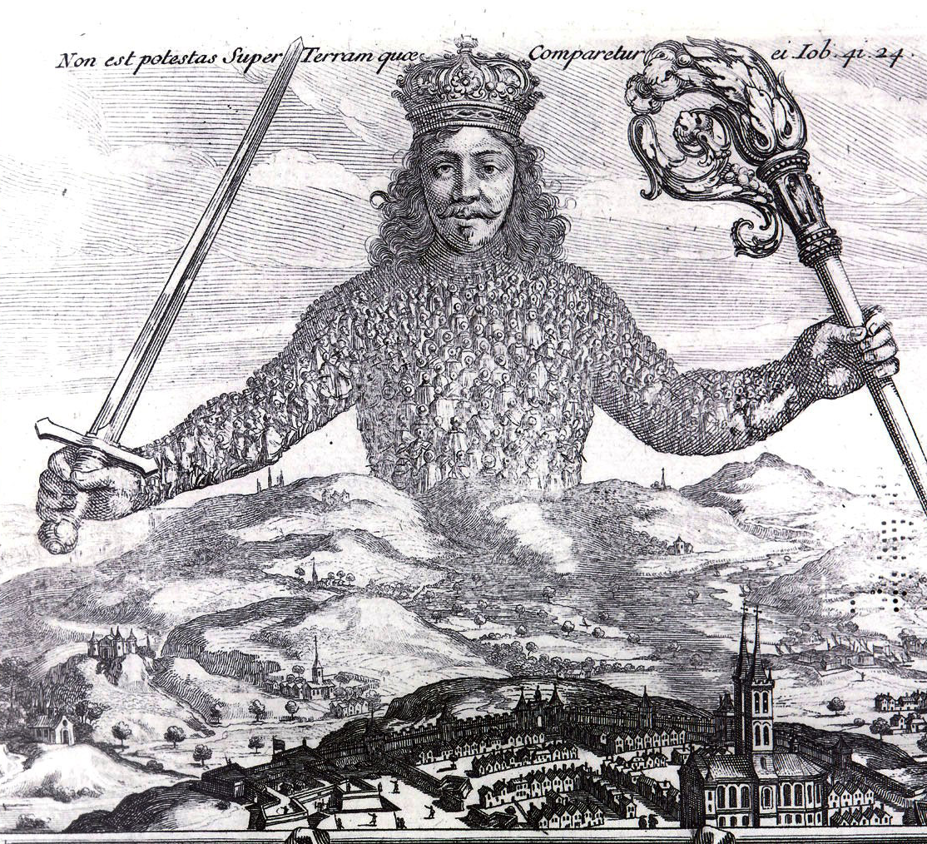
The Leviathan Frontispiece
Activity:
Find a copy of the Leviathan frontispiece (or look at the copy on the board). Speak to one or two people near you. What does this image tell us about the book?

Slide 4
Appetites and aversions
Deliberation: when in the mind of man, Appetites, Aversions, Hopes, and Feares, concerning one and the same thing arise alternately, and diverse good and evil consequences of the doing, or omitting of the thing propounded, come successively into our thoughts.
The Will: In deliberation, the last appetite, or aversion, immediately adhering to the action, or to the omission thereof, is what we call the will; the Act (not the faculty) of willing.
Will, therefore, is the last appetite in deliberating. (Leviathan, Ch. VI)

Slide 5
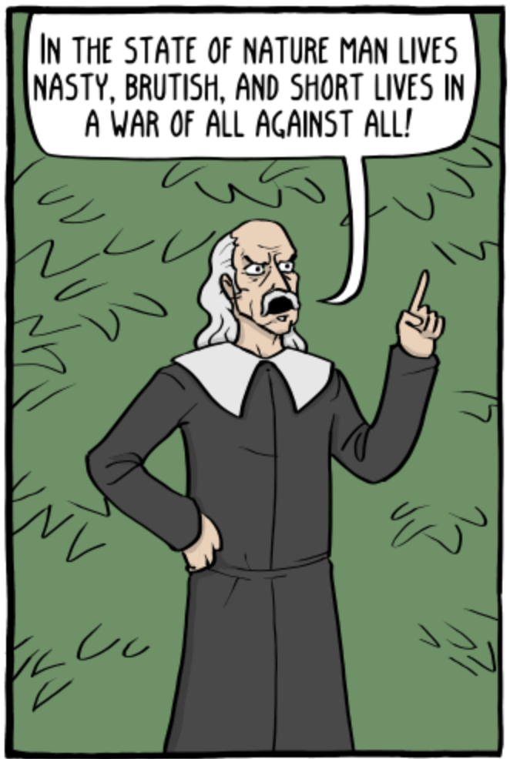
The state of nature
Whatsoever therefore is consequent to a time of Warre, where everyman is Enemy to every man; the same is consequent to the time, wherein men live without other security, than what their own strength, and their own invention shall furnish them withall. In such condition, there is no place for Industry; because the fruit thereof is uncertain: and consequently no Culture of the Earth; no Navigation, nor use of the commodities that may be imported by Sea; no commodious Building; no Instruments of moving, and removing such things as require force; no Knowledge of the face of the Earth; no account of Time; no Arts; no Letters; no Society; and which is worst of all, continuall feare, and danger of violent death; And the life of man solitary, poore, nasty, brutish and short. (Leviathan, Ch. XIII)

Slide 6
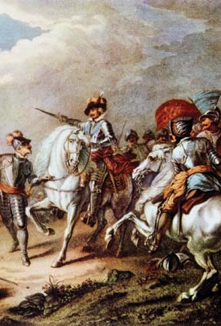
The state of nature
What are Hobbes’ assumptions about the state of nature?
Egoism
Scarcity
Diffidence
Glory-seeking
Natural equality

Slide 7
Hobbes on Human nature: are we only self-interested?
What is Hobbes’ view of human nature?
Is conflict in the state of nature due to egoism (i.e., are human beings solely motivated by self-interest)?
How should we understand the state of nature in light of your answers to these questions?
“Also, because there be some that taking pleasure in contemplating their own power in the acts of conquest, which they pursue farther than their security requires, if others (that otherwise would be glad to be at ease within modest bounds) should not by invasion increase their power, they would not be able, long time, by standing only on their defence, to subsist.” (Leviathan, Ch. 13.4)
“In the state of nature there is in all men a will to do harm, but not for the same reason or with equal culpability. [The modest man] practices the equality of nature […] Another, supposing himself superior to others, wants to be allowed everything. […] That is the sign of an aggressive character. In his case, the will to do harm derives from vainglory.” (On the citizen, Ch. 1.4)
Recommended article on this topic: Chung (2015). “Hobbes’s state of nature: a modern Bayesian game-theoretic analysis”, Journal of the American Philosophical Association 1(3): 485-508. Link here.

Slide 8
Considering the method
Is Hobbes right about human nature and the state of nature?
What does Hobbes gain by describing the state of nature?
Do you think this is a useful way to approach doing political theory?

Slide 9
Talking about rights

Slide 10
Extra resources
In Our Time episode on Hobbes
In Our Time episode on Sovereignty
Talking Politics episode on Hobbes and the state
Philosophy Bites episode on the Leviathan in context
Not one, but two Existential Comics related to Hobbes

